Slide 1

SARA II YEAR MINI PROJECT
MERGE CSV FILES….

Slide 2
MERGE CSV FILES
PROJECT NAME : MERGE CSV FILES
DEPARTMENT : II-YEAR CSE-B
TEAM LEADER : NAGA SHARAVANESH S
TEAM MEMBERS : SRIRAM K R
SURIYA PRAKASH M
THOLKAPPIYAN M

Slide 3

CONTENTS!!
DEFINITION
DIFFERENCE B\W CSV AND EXCEL
CREATION
DISPLAY
MERGING
TWO CSV FILES
ALL CSV FILES

Slide 4
WHAT IS CSV FILES?
CSV (Comma Separated Values) is a simple file format used to store tabular data, such as a spreadsheet or database.
A CSV file stores tabular data (numbers and text) in plain text.
Each line of the file is a data record.
Each record consists of one or more fields, separated by commas.
The use of the comma as a field separator is the source of the name for this file format.
For working CSV files in Python, there is an inbuilt module called csv.

Slide 5
OBJECTIVES
CSV files are mostly used for importing and exporting important information, such as customer or order data, to and from your database.
A more practical example of this would be an ecommerce business that buys customer data from a social media website.
Saves a workbook as a comma-delimited text file for use on another Windows operating system, and ensures that tab characters, line breaks, and other characters are interpreted correctly.

Slide 6
DIFFERENCE BETWEEN CSV AND EXCEL FILES
The difference between CSV and XLS file formats is that CSV format is a plain text format in which values are separated by commas (Comma Separated Values), while XLS file format is an Excel Sheets binary file format which holds information about all the worksheets in a file, including both content and formatting.
The difference is that in CSV or comma-separated values, the data is in text format separated by commas. While in Excel or xls., information is in tabular form in rows and columns.

Slide 7
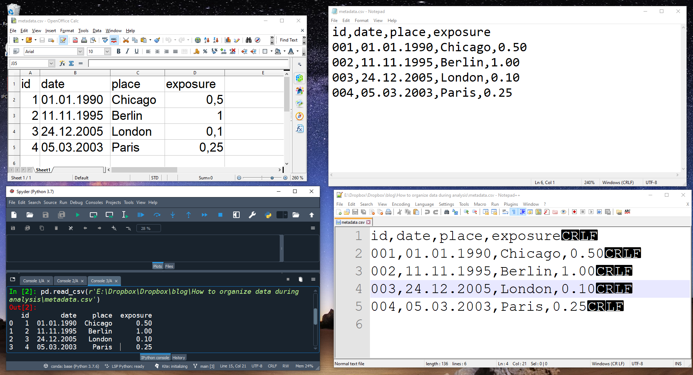
CREATING A CSV FILES
import csv
import sys
def getdata():
f=open("D:\sara\project\csv_file_excel.csv","a",newline='')
w=csv.writer(f)
print("FUNCTION FOR WRITE A CSV FILE TO EXCEL")
n=int(input("Enter the number of records:"))
for i in range(n):
r=int(input("Enter the serial Number:"))
name=input("Enter the Name of the Student:")
batch=int(input("Enter the batch number:"))
dept=input("Enter the department:")
l=[r,name,batch,dept]
w.writerow(l)
f.close()

Slide 8
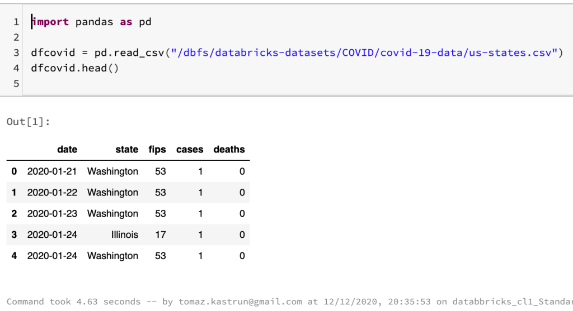
DISPLAY THE CSV FILES
def displaydata():
print("FUNCTION FOR READ A CSV FILE FROM EXCEL")
f=open("D:\sara\project\csv_file_excel.csv","r")
s=csv.reader(f)
for i in s:
print(i)
f.close()
This Photo by Unknown Author is licensed under CC BY-NC

Slide 9
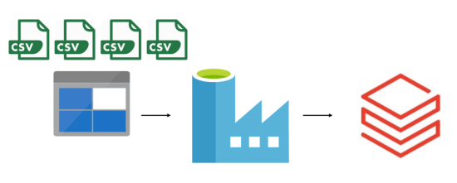
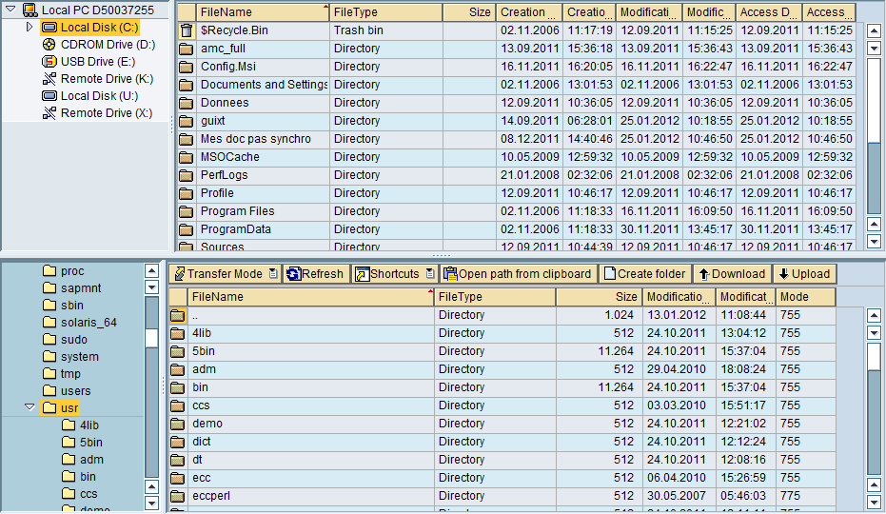
MERGING TWO CSV FILES
import pandas as pd
df=pd.concat(map(pd.read_csv,['dummy1.csv','dummy2.csv']),ignore_index=True)
print(df)
This Photo by Unknown Author is licensed under CC BY-SA

Slide 10
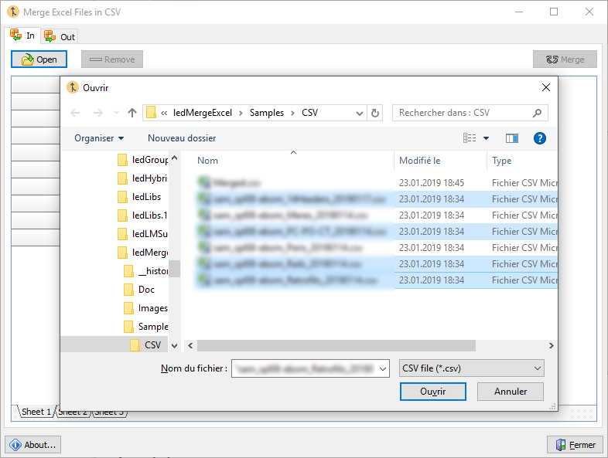
MERGING ALL CSV FILES
import os
import glob
import pandas as pd
os.chdir("D:\sara\project")
extension = 'csv'
all_filenames = [i for i in glob.glob('*.{}'.format(extension))]
#combine all files in the list
combined_csv = pd.concat([pd.read_csv(f) for f in all_filenames ])
#export to csv
combined_csv.to_csv( "combined_csv.csv", index=True)
print(combined_csv)

Slide 11


